Slide 1
GitHub Basics

Slide 2

Attendance form

Slide 3

Why do we use GitHub?
Allows us to push code to one location.
Allows for centralized collaboration and version control
Promotes efficiency because more than one person is aware of the changes

Slide 4
Installing GitHub Desktop
Go to the git page here and click "64-bit git for Windows Setup."
Complete the install. There are a lot of options, but the ones for you are usually already selected.
Go to the GitHub Desktop page here and click "Download for Windows (64bit)."
When prompted, click Run.
Allow the installation to download and install.
Now that you have all of your Desktop applications set up for GitHub, make sure you have an account.
Login and setup your account.

Slide 5
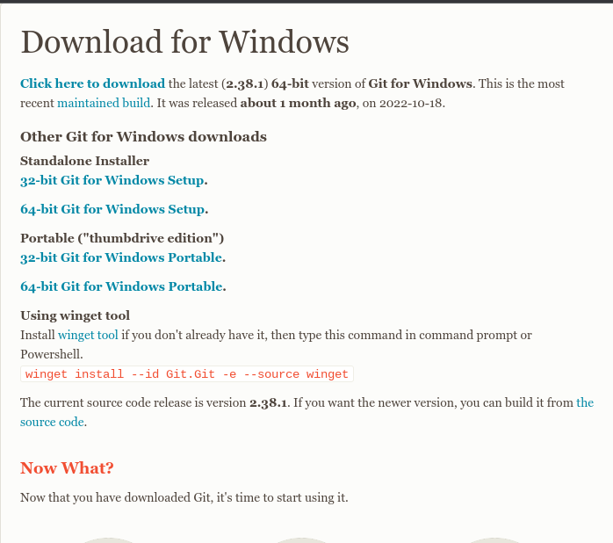
Git

Slide 6
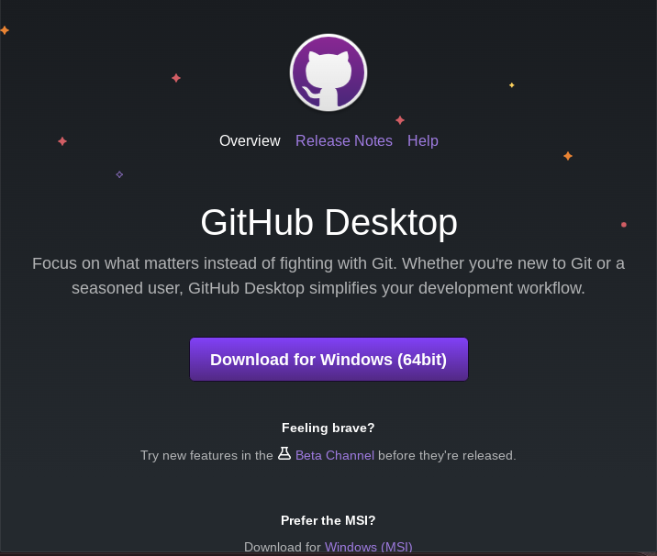
GitHub Desktop

Slide 7
The Basics
Writing a codebase and publishing it
Pull: Make a pull request from that repository → creates a local repository on your device
Commit: After making changes in your repository, you can commit the changes.
Push: Push your repository to GitHub, which ultimately replaces the original repository with your changed repository

Slide 8
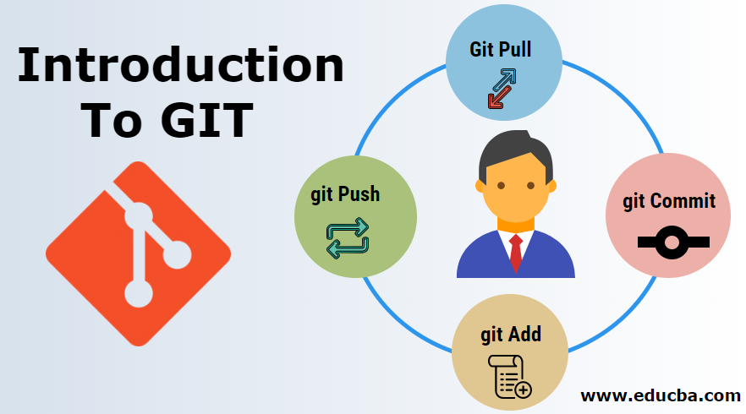

Slide 9
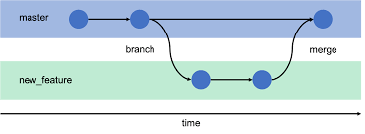
Using branches
Allows us to avoid merge errors by having a separate place to work on code

Slide 10
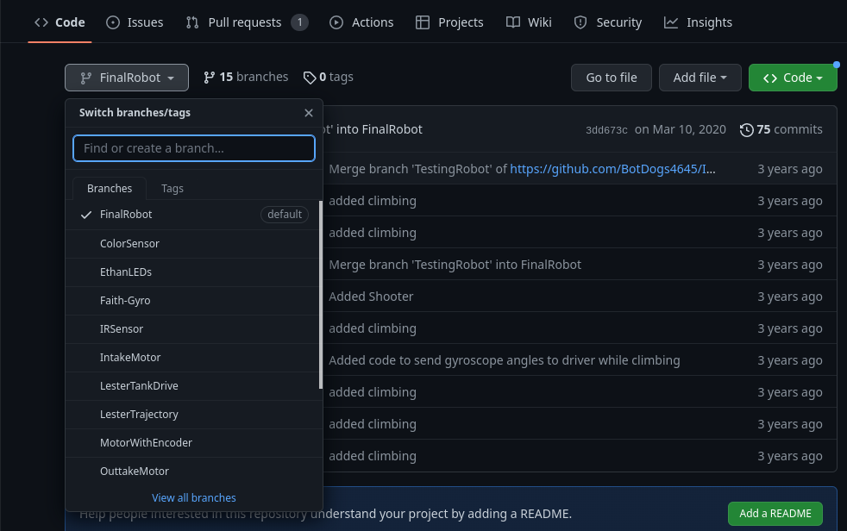
Example of Branches

Slide 11
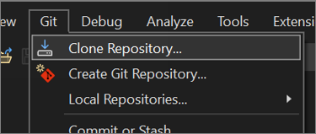
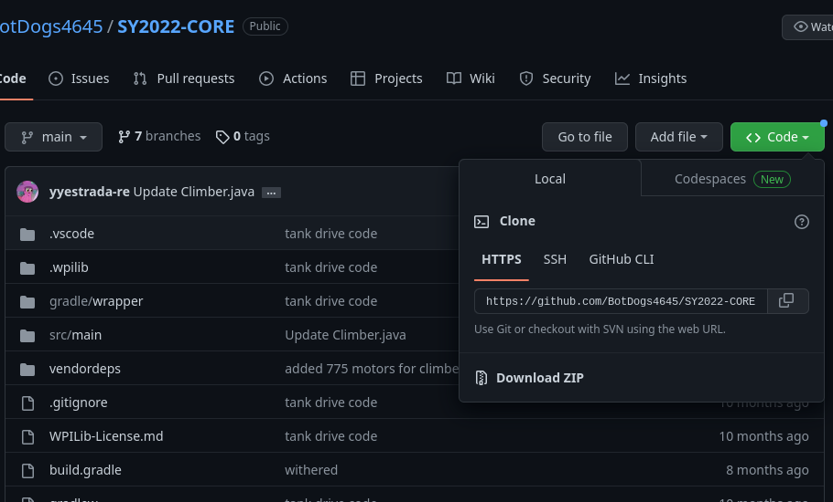
Cloning a Repo

Slide 12
Cloning a Repo cont.
Make sure to save the location of the folder you saved the repo in
Make sure to click ¨Fetch Origin¨ at the top on the farthest right box.
Can now be found by clicking ¨Repository¨, at the top and clicking ¨Show in Explorer¨
Select and save that directory. Open 2022 WPILib VS Code and select "Open Folder."
Select and save that directory. Open 2022 WPILib VS Code and select "Open Folder."
That should open up your cloned repo on 2022 WPILib VS Code.

Slide 13
Pushing
After making changes to the repo you made a pull request to, GitHub will ask you if you want to commit those changes to the official local repo.
Go to GitHub Desktop and open the codebase you made changes in and the right branch
In the bottom left, you have gained the option to commit your changes to your local repo.

Slide 14
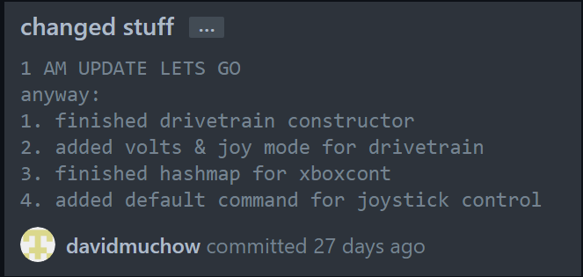
Pushing cont.
DON´T JUST COMMIT YOUR CHANGES WITHOUT SPECIFYING WHAT YOU CHANGED
Press ¨Commit to¨ branch name
Push to GitHub by pressing ¨Push Origin¨ in the top right

Slide 15
Resources
Dave and Aidan´s Wiki
BotDogs GitHub Process

